Slide 1
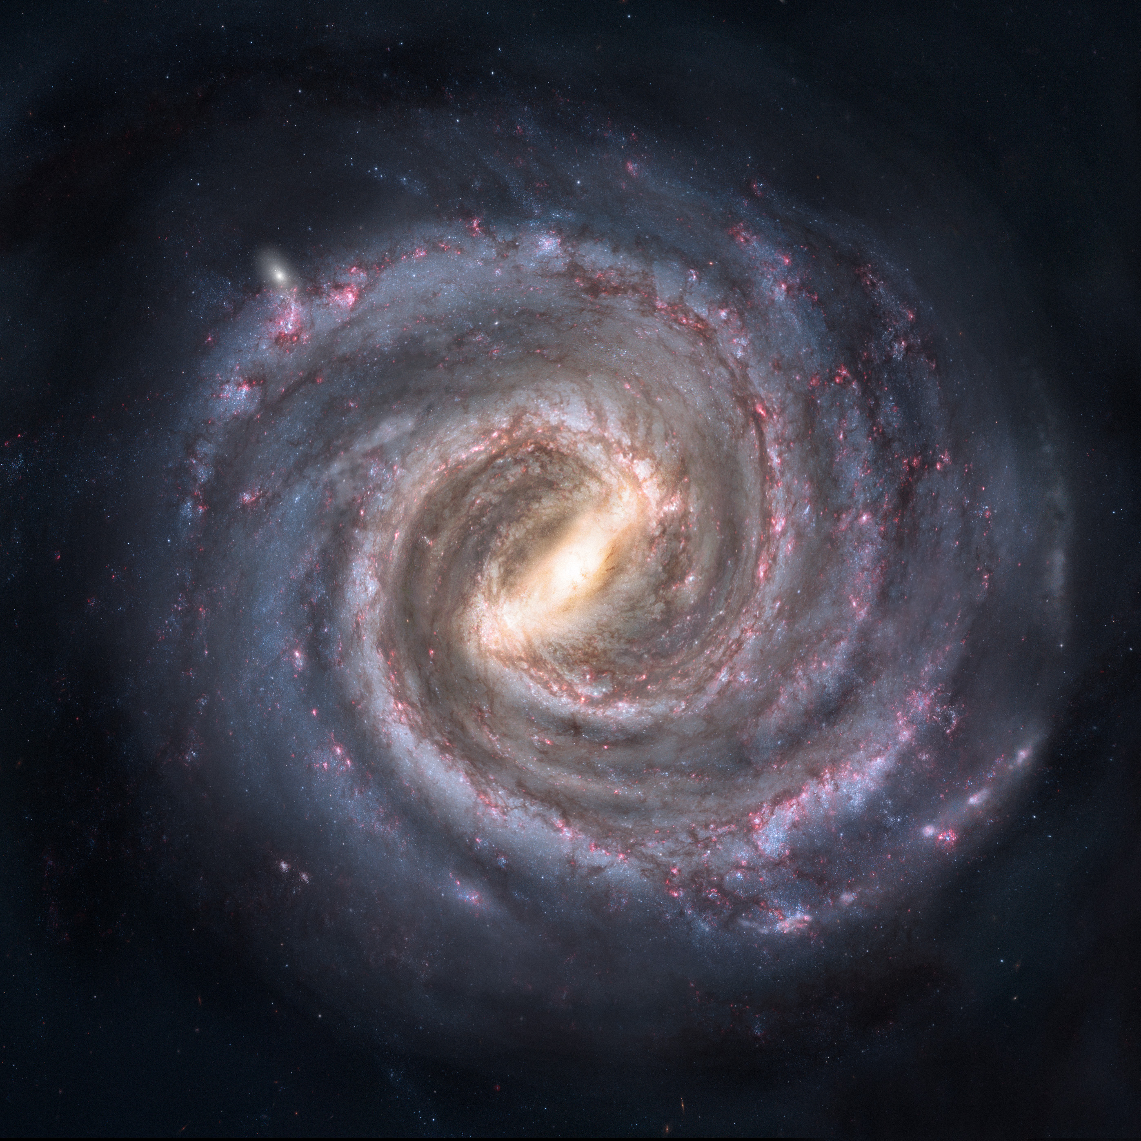






Time Variability in Active Galactic Nuclei: What it tells us
David Starkey
In collaboration with Keith Horne, Yue Shen, J Li & the sloan digital sky survey project
Tuesday 11th September 2018
Notes:
Milky way – gas – dust –stars -Earth
Black holes lie at the centre of all galaxies and sometimes, they are feeding
Top: - Carina Nebula, an immense cauldron of gas and dust that lies approximately 7500 light-years from Earth in the constellation of Carina, the Keel.
Bot: - 3c273 Quasar (bright AGN).
Point: difficult in early 20th century to distinguish the spectra of stars from AGN.

Slide 2
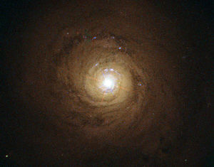
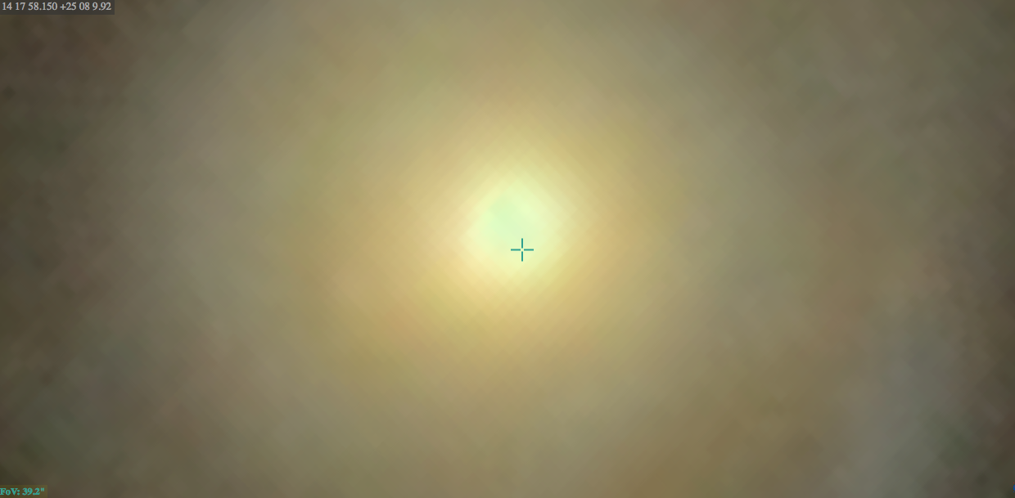
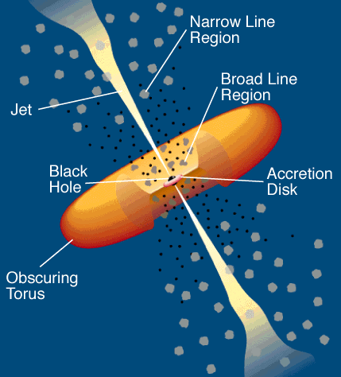
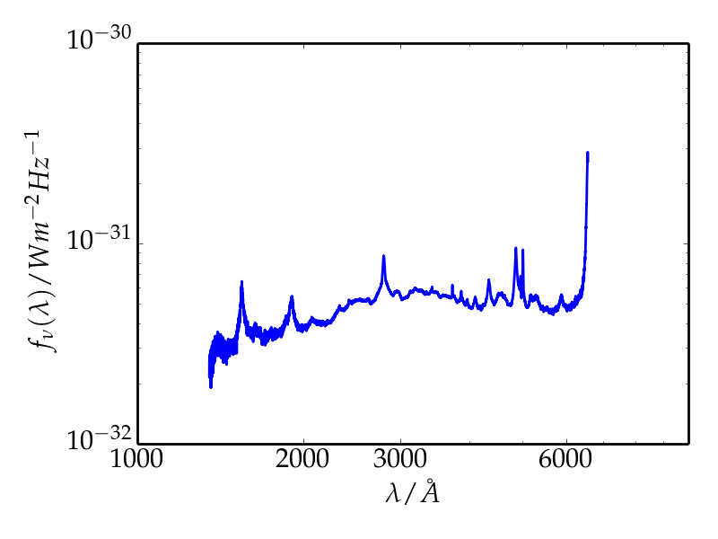
Active Galaxies
Emit radiation from a source other than the stars and gas in the galaxy.
The nuclei (AGN) contain a black hole (10⁷ -10⁹ M_{o}), accretion disc, and gas orbiting at 10’s to 1000’s of light days (ld) surrounded by a dusty torus. – 1ld = 2.6 x 10¹³m
~1000 ld
1.25x10⁷ ld
5x10⁷ light days (ld)
Broad Lines
C IV
Mg II
Hβ
[Urry and Padovani 1995]
Accretion Disk Continuum
[SDSS]
[SDSS]
Notes:
Active galactic nuclei (AGN) are among the most pow-
erful sources of energy in the Universe, where the bright-
est quasars can outshine all of the stars in their host
galaxy by 100 times.
Big line left (H alpha), 2nd moderate peak – Ca2, next (not double spike) Si, next He2, tall one on right (He1)
1pc ~ 1000 Light days
Show diagram of various components of AGN with relative size scales.
. Draw a circle around accretion disc bit and say (‘I live in this part of the AGN’)

Slide 3

Active Galaxies
Emit radiation from a source other than the stars and gas in the galaxy.
The nuclei (AGN) contain a black hole (10⁷ -10⁹ M_{o}), accretion disc, and gas orbiting at 10’s to 1000’s of light days (ld) surrounded by a dusty torus. – 1ld = 2.6 x 10¹³m
~1000 ld
1.25x10⁷ ld
5x10⁷ light days (ld)
Broad Lines
C IV
Mg II
Hβ
[Urry and Padovani 1995]
Accretion Disk Continuum
[SDSS]
[SDSS]
Notes:
Active galactic nuclei (AGN) are among the most pow-
erful sources of energy in the Universe, where the bright-
est quasars can outshine all of the stars in their host
galaxy by 100 times.
Big line left (H alpha), 2nd moderate peak – Ca2, next (not double spike) Si, next He2, tall one on right (He1)
1pc ~ 1000 Light days
Show diagram of various components of AGN with relative size scales.
. Draw a circle around accretion disc bit and say (‘I live in this part of the AGN’)

Slide 4
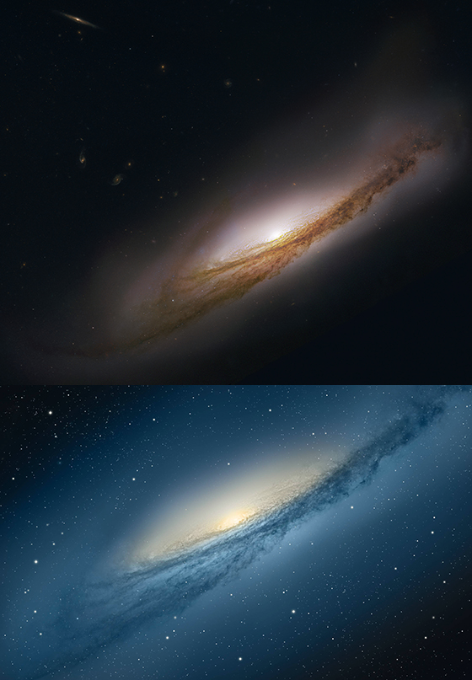
Why Study AGN?
AGN among most luminous objects in the universe!
How does the feeding process work.
What do the accretion discs look like up close.
Is the process analogous to smaller mass X-ray Binaries?
How do you fuel AGN? How do you get matter to fall:
from Kpc sub pc into AGN accretion disc black hole
Credit: HST
Notes:
. Some galaxies are active. Does this feature affect the behavior of the host?
. How are the AGN fueled. How to get material to lose angular momentum and fall into disc – planets solar system analogy
. To study these questions, it would be nice to see what you are looking at… that’s the problem.

Slide 5
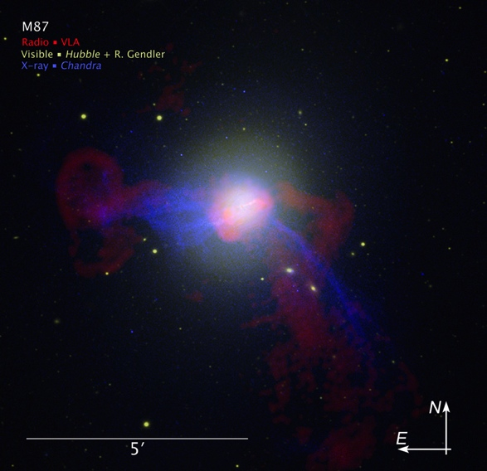
What Size Telescope is Needed to Resolve the Accretion Disk?
For a 10⁸ M_{sun} black hole, most accretion disc emission emitted within ~10 light days (LD).
R
θ
d_{M87}
Radio – VLA
Visible – HST
X-ray - Chandra
For M87 (nearby AGN), d_{M87}=5.2 x 10⁷ Lyr (~1.7 x 10¹⁵ ld)
Θ= 1.2 nano arcseconds
Telescope Diameter…
~ 30,000 km
Notes:
Recipe for working out the telescope size given a required resolution…

Slide 6

Resolution Problem
Notes:
ESO proposed an Overwhelmingly Large Teleescope but was scrapped several years ago because of overwhelmingly large buget
ELVES earth shatteringly large very enormous super telescope

Slide 7
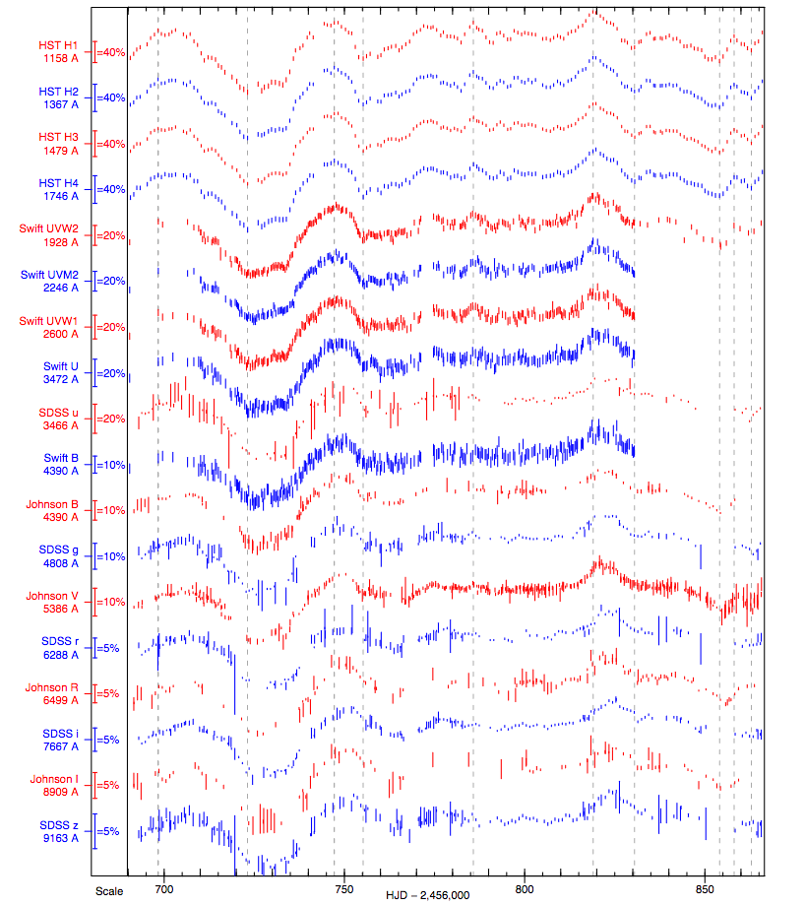
AGN Variability
AGN variability correlated across all wavelengths over week-ish timescales.
150 days
Notes:
Question is can we use this variability to map the unresolvable accreiton disc

Slide 8
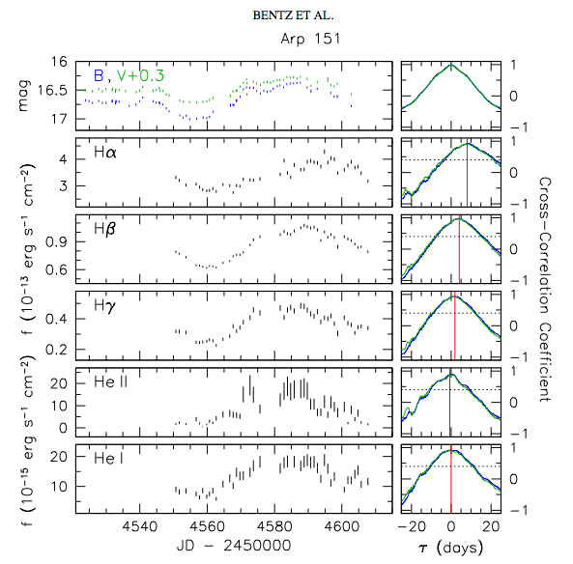
Reverberation Mapping (Blanford and Mckee 1982)
Bentz et al (2010) Arp 151
λ~ 4000 Angstroms
Flux
Emission Line variability tends to lag continuum variability.
~1000 ld
Time (days)
Time delays between light curves at 2 or more wavelengths hold information about the AGN (BLR size, M_{BH} etc).
Cross correlation normally used to get time lags.
Hα λ=6563 A
~10ld
Shorter U.V optical
λ~4000 A
[Urry and Padovani 1995]
Notes:
The delays above refer to delays between the accretion disk emission & that from the broad lines. To infer something about the accretion disk (inclination accretion rate are what I have worked on so far) we look for time delays between shorter and longer wavelength continuum emission. Cross correlation good because it is fast, but only provides a single vaue for the time lag (mean lag). This gives only a the most simplistic view of the relatie size of the BLR. Wee need it for the accretion disk

Slide 9
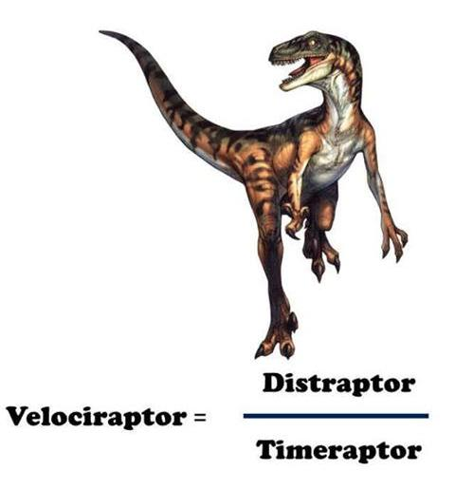
Origin of the Time Delay
Broad Line
Clouds
P₃
To Observer
P₂
Accretion Disk
P₁
Light travel time effects cause broad line emission to lag continuum emission from the disc.
For path length P, Lag = ( |P₂ + P₃| - |P₁| ) / c

Slide 10
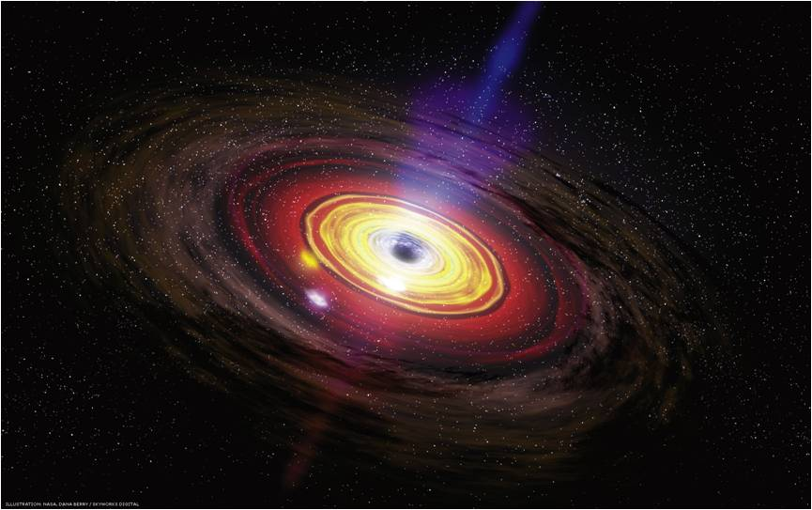
Do we Measure Delays Within the Accretion Disc?
If interested in the disc, need to measure shorter time delays.
Cross correlation ok, but lacks detailed information on disc structure.
Hα λ=6563 A
Shorter U.V optical
λ~4000 A
Delays? τ₁ τ₂ τ₃
[Urry and Padovani 1995]
Do we observe interband continuum – continuum light curve delays can these to tell us something about the accretion disk?
Geometry.
Black hole accretion rate.
Temperature structure.
Notes:
Chop disc up into discrete reprocessing site and observe time delays like with broad lines

Slide 11
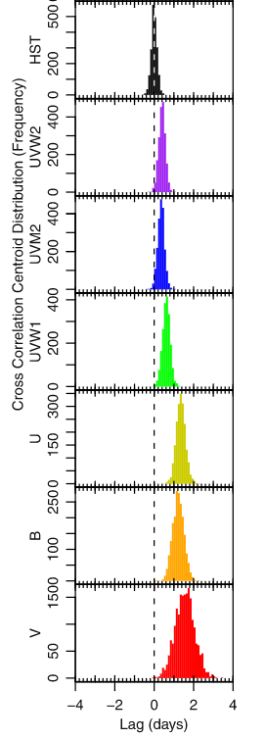
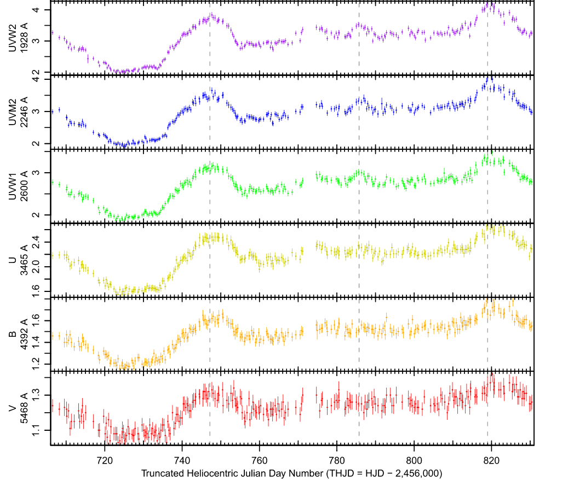
AGN Continuum Lags in NGC 5548
Time lags are measurable. What do they mean for the accretion disc.
Notes:
Time lags up to several days between the HST 1368A and V band.

Slide 12
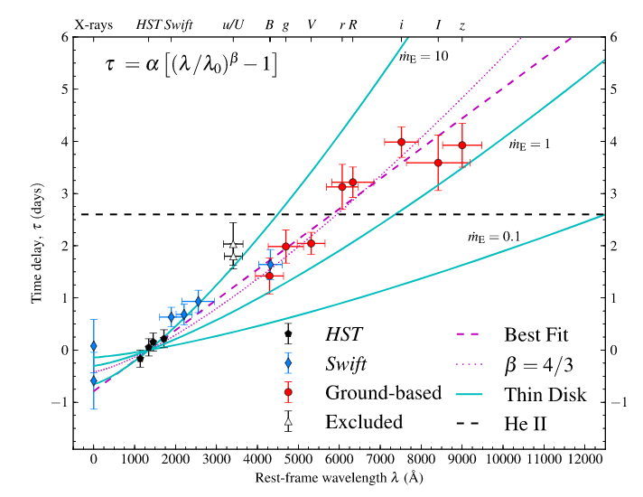
Lags increase with wavelength

Slide 13
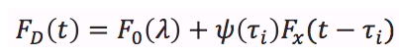
Origins of Variability: A First Order Approach?
Hot inner accretion drives variability.
Model as a point source for speed and simplicity.
F_{x}(t)
τ_{D}
Delay Distribution ψ(τ )
F_{x}(t)
τ_{D}
F_{D}(t)
F_{D}(t)
Delay (τ)
Time
observer
Notes:
SAY LAMPPOST ALOT
Expect longer wavelength light curves – longer delays – come from cooler regions of the disc -- emitting at larger radii

Slide 14
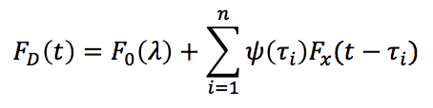
Several Discrete Reprocessing Sites
To Observer
Delay Distribution ψ(τ )
F_{x}(t)
τ_{D}
i = 1
i = 4
Delay (τ)
i = 2
i = 3
Notes:
Slightly more complex is if we have a set of discrete reprocessing sites. The total reponse from the disk then becomes a sum

Slide 15
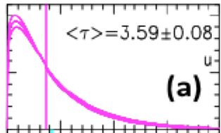
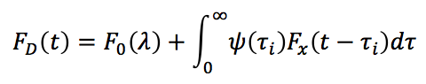
Accretion Disk Time Delays – Full Treatment
F_{x}(t)
ψ(τ|λ )
F_{D}(t)
Delay τ
<τ>
Time (days)
Mean delays scale with wavelength as…
<τ> α λ^{4/3}
Evaluate numerically
Notes:
Increasing to a continuum of points, continuous disk, we replace the sum by an integral (convolution integral)
. response function very important (will be talking a lot about it) and will now spend a few slides discussing how it is affected by the disc geometry.
. Being able to fit a model that includes the full shape of the response much better than just having a a single delay (response function includes all the geometry of the disc).

Slide 16
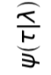
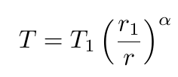
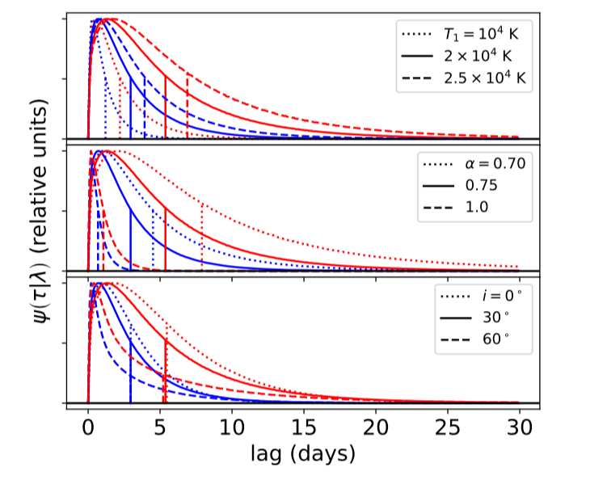
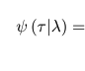
How do we calculate the response function?
Temperature
Assume a disk temperature profile with variations centrally driven.
Split disk into annuli.
Need to consider that each annulus contributes at all wavelengths.
The inner annuli are hotter but the outer annuli have more area.
10⁴K
T₁
1 ld
10⁶K
α
R /(light days)
i
f(T₁,α,i)

Slide 17
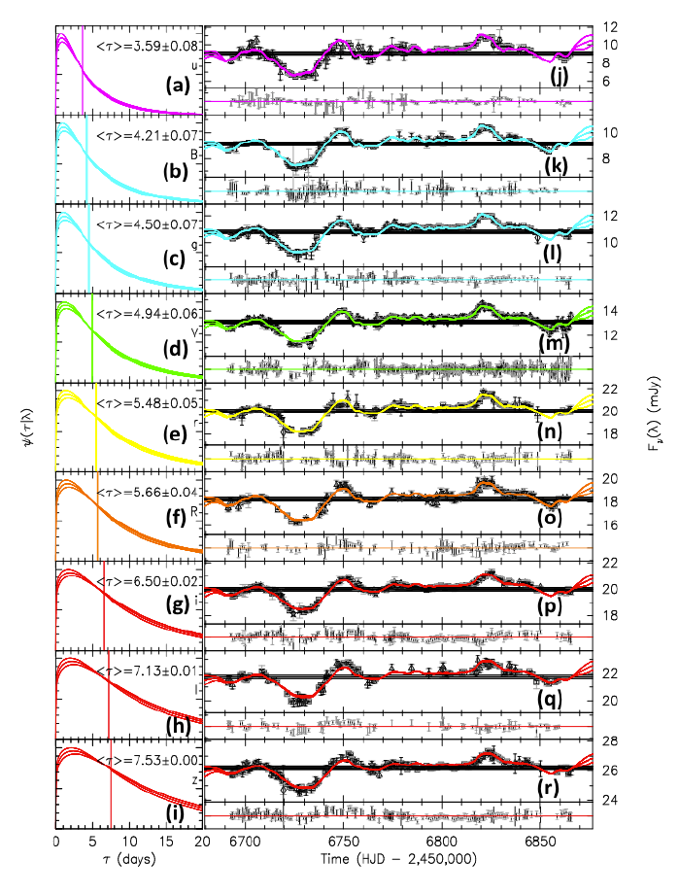
Ground

Slide 18
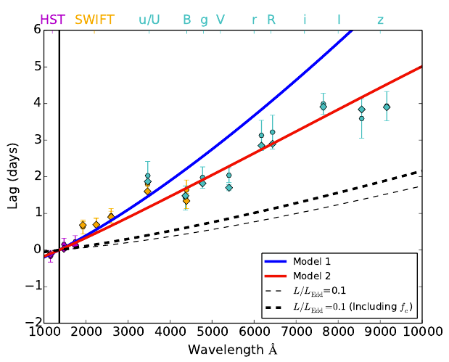
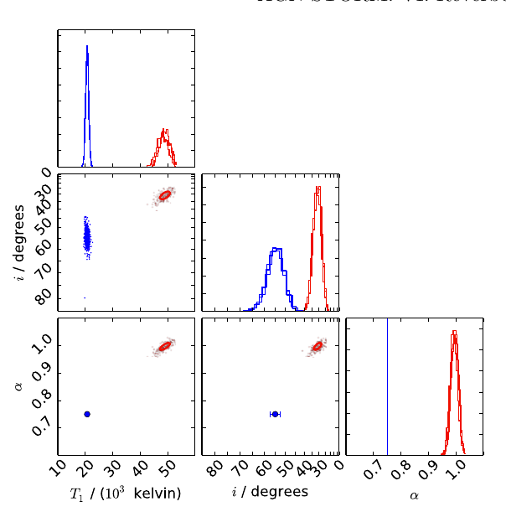
Implications for disk parameters and mean lags
T₁
i
Fit two models
-Model 1: α == 0.75, fit T₁ and I
-Model 2: fit α, T₁ and I
α
Lags from both models 1,2 and cross correlation methods give lags too large.
Starkey et al (submitted)
Notes:
Eddington limit, is the maximum luminosity agn can achieve when there is balance between the force of radiation acting outward and the gravitational force acting inward

Slide 19
Lags increase with wavelength

Slide 20
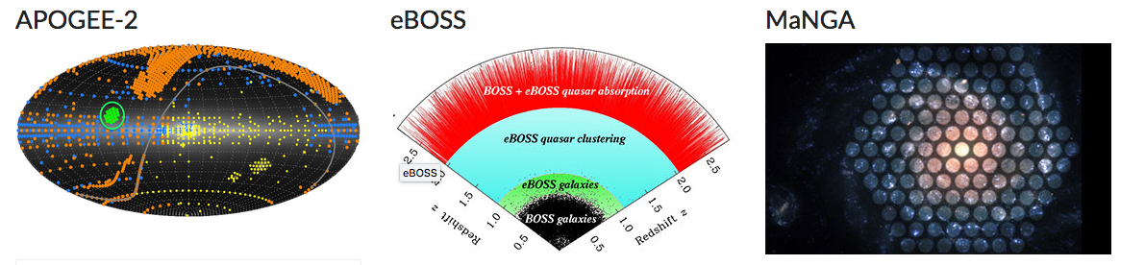
Sloan Digital Sky Survey
Major multi imaging spectral imaging and spectroscopic redshift survey
Apache Point Observatory, New Mexico
Began in 1999 Nov on 4th generation of surveys
Study all sorts. Milky way, nearby galaxies and the early universe.
Notes:
Apogee Local observations of Milkyway, star formation, buldge disk dynamics,
extending precision cosmological measurements to a critical early phase of cosmic history (eBOSS)
Manga if you want to study what goes on in different parts of other galaxies you can take spectra of the specfic regions using this hoineycomb approach (IFU)

Slide 21

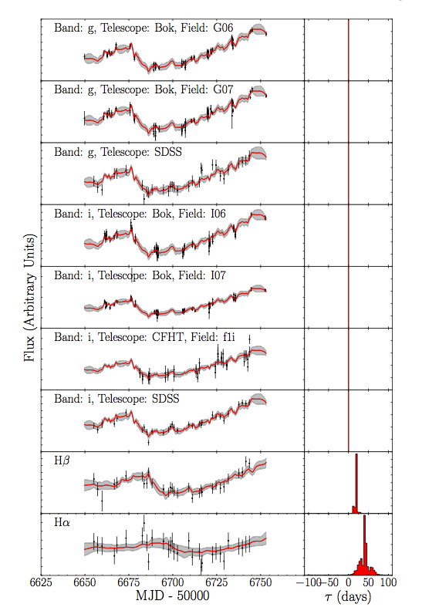
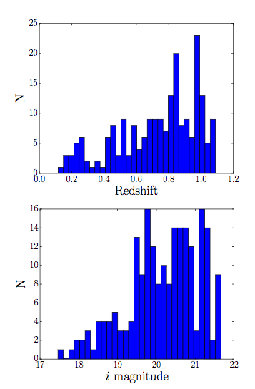
Sloan Digital Sky Survey – Reverberation Mapping
SCIENCE GOALS: To explore the potential of reverberation mapping for a large homogenous sample of broad-line quasars.
849 quasar sample i < 21.7 (flux limited) in 7 deg².
222 of these with required redshift range for detectable Hβ line (useful for estimating M_{BH})
Notes:
FLUX LIMITED SAMPLE
NGC 5548 much closer and so much brighter i band ~ 13
hbeta wavelength n = 4 -> 2, lambda = 4861A

Slide 22
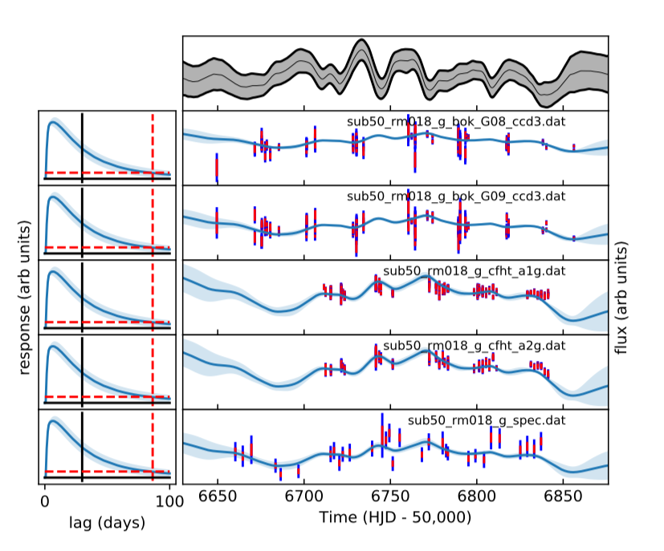
Applying CREAM to 222 SDSS targets
RMID 18
g – band
4770Å

Slide 23
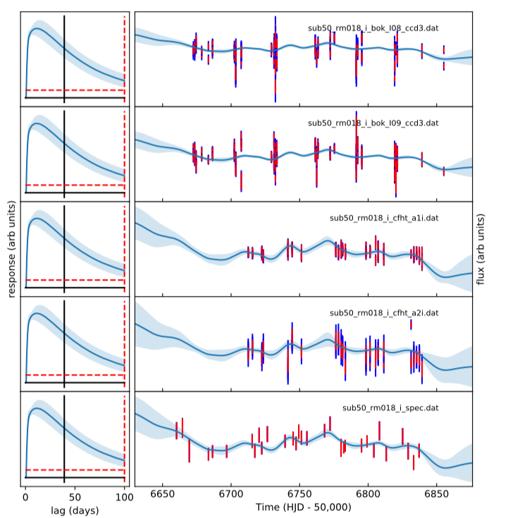
RMID 18
i – band
7625Å

Slide 24
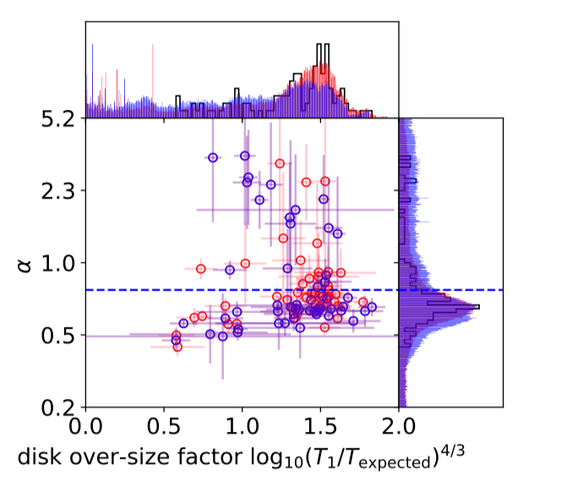
Implication for accretion disk (size and temperature slope)
Results suggest that the expected temperature slope agrees with α = -3/4 but that the disk sizes are much larger than expected for standard thin disks.

Slide 25
Conclusions & Future Work
RM can be used to investigate the temperature profiles of quasar accretion disks.
These agree with the standard accretion disk theory in terms of temperature slope (with α = ¾) but lags indicate disk sizes higher than predicted by standard disk theory (factors of 2 – 10).
Does the standard model need to be modified? …
Interpretation?
Double reprocessing region (Gardner & Done 2016)
UV/optical
FUV
Tilted inner disc (Starkey et al in prep)
Hard X-rays
FUV
Hard X-rays
UV/optical
Notes:
Ian Mchardy has lots of experience with X-ray reverberation mapping so it would be great to get his views & collaborate on possible mechanism to (if possible constrain) the shape of the reprocessing region in the high energy regime (close in).

